Slide 1
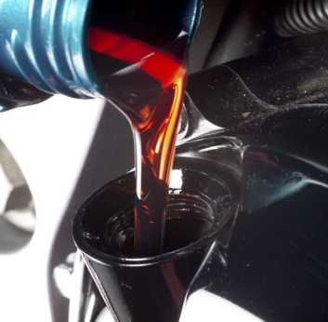
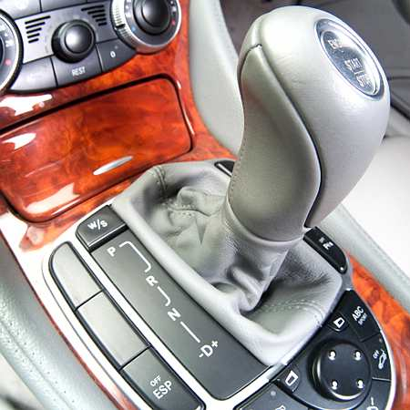
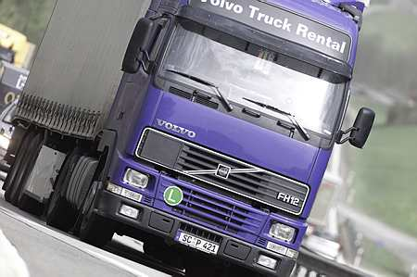
CEC 2013 - Role of CEC in Developing Tests for the European Automotive Industry
10th ICIS Middle Eastern Base Oils & Lubricants Conference
7 October 2013, Dubai
Dr Ian Field – Vice-Chairman, CEC Management Board

Slide 2
Who Needs Lubricant Tests?
Need to define lubricants that will protect their engines
Want to market high quality lubricants with no risk of field problems
ALL NEED
Well designed, reliable and cost effective engine tests that cover all engine parameters and match real field performance
ACEA
ATIEL
ATC
Want to market high quality lubricant additive packages with no risk of field problems and design new formulations that add value and meet future demands

Slide 3
Who Manages CEC?
OEMs
www.acea.be
Oil Marketers
www.atc-europe.org
CEC Board of Directors is made up from members representing all four Industry Associations
ACEA
ATIEL
ATC
Concawe
Additive marketers and formulators
www.atiel.org
Fuel marketers
www.concawe.be

Slide 4
What is the CEC?
The Co-ordinating European Council for the development of performance tests for transportation fuels, lubricants and other fluids
CEC is an Industry-based organisation for the development of Test Procedures and Methods:
Automotive Fuels, Engine Oils & Transmission Fluids
Marine & Large Engine Oils
Two-stroke Engine Oils
Associated Bench Tests
Industrial & Hydraulic Fluids

Slide 5
CEC Mission Statement

Slide 6
CEC Mission
TMS for bench tests
Managed by industry stakeholders
Quality processes for test labs
Rating workshops
Use of lead lab to develop new tests
All CEC processes combine to provide high quality tests that will reliably assess the true performance of a lubricant or fuel
Support of statistics group
Terms of reference for new test development
Monitoring and referencing of test engines
Expert fuels and lubes advisors

Slide 7
CEC organisation

Slide 8
CEC Organisation
CONCAWE
ACEA
ATIEL
ATC
CEC Secretariat
CEC Board
Support Groups
TDG
SG

Slide 9
CEC Management Board
Alister Jackson – ExxonMobil
Benoît Engelen – Total
Vincent Panel – BP
Nick Clague – SK Lubricants
Suhair Abdelhalim – Ford
Paul Greening – ACEA director
Ian Field – Infineum
Frank Stunnenberg – Chevron Oronite
CONCAWE
ACEA
ATIEL
ATC
Chairman
Anders Röj – ACEA (Volvo Technology AB)
CEC Board
CEC Secretariat
Articles of Association | Bye-Laws | Guidelines | Test Methods
Legal requirement | Constitution | How to operate | End result
Support Groups
TDG
SG

Slide 10
Test development process

Slide 11
CEC Test development process – TDG’s
CEC tests are often introduced through the AAA (ACEA, ATIEL, ATC) group
Usually initiated by an OEM
The CEC Secretariat produces tender document for one lead laboratory to develop the test
Tenders are evaluated by a small CEC MB team
The Lead lab is chosen and Sponsors are invited to join the Test development group (TDG) to pay for the test development
Test is then developed with a draft CEC procedure established and repeatability results analysed by the groups Statistical representative (SDG)
Lead laboratory assists other Sponsors to install the test and reproducibility established from RR results from these additional labs
If SDG recommends acceptance CEC MB will approve as a valid CEC test
New Valid CEC Lubricant tests usually go into the next ACEA Oil sequences

Slide 12
Quality Requirements & Support Groups

Slide 13
Test Laboratory Quality Requirements
All laboratories running CEC tests must have an ISO 9001 equivalent system for the general quality definition and procedures
For engine/rig tests an ISO 17025 equivalent system is required
Laboratories must actively participate in CEC Group activities, meetings and round robin tests
Every laboratory must contribute to the improvement of the test method and share data/experience

Slide 14
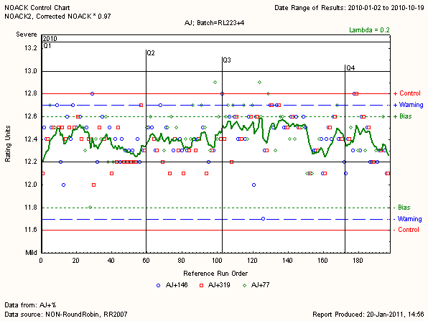
CEC Web-based Test Monitoring
Simple process for uploading Reference data and Graphical software for analysis of data
Location: www.cec-tms.net

Slide 15
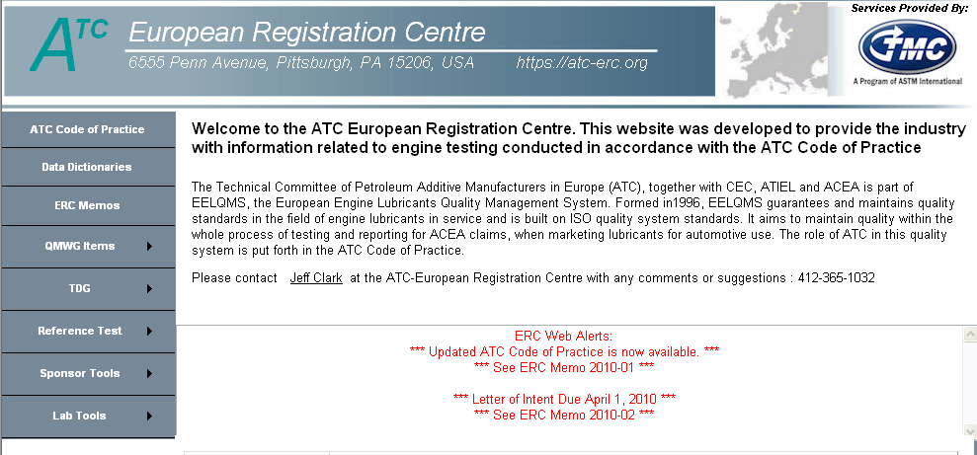
ERC – ATC's European Registration Centre https://atc-erc.org
Candidate test registration database
Reference test registration database and charting

Slide 16
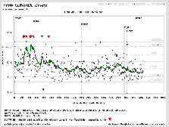
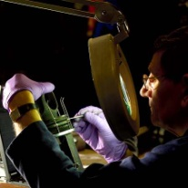
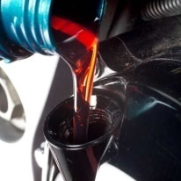
Support Groups
Statistical Development Group – SDG
A designated Statistical Development Liaison Officer allocated to each Group
Assuring Quality of Test Results
Rating Group – RG
Regular Workshops for Raters
Ensure Rating is consistent across the industry
Reference Fuels Group – RFG
A suite of reference fuels are supplied for use within TDG and SG test groups to ensure consistency of fuel used
Reference Oils Group – ROG
Reference oils are supplied to TDG and SG test groups to enable the initial development of tests using calibration oils and to ensure correct severity of testing by running Round Robins and/or set reference frequency protocols

Slide 17
New and Potential Test Developments

Slide 18
New Developments - In progress
CEC L-39-96 Seals Special Project Group to look for new elastomers
TDG L-104 OM646LA, Effects of Biodiesel Fuel
TDG L-106 DV6 Euro 5, Soot Handling Test
TDG-L-107 M271EVO Sludge Test
TDG-L-109 Oxidation Test in the Presence of Biodiesel Fuel
TDG-L-111 EP6 Gasoline engine test for high temperature deposits

Slide 19
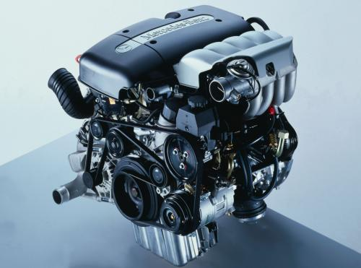
New Test Development Group (TDG): CEC TDG-L-104 – Effects of Biodiesel Test (OM646LA)
Terms of Reference for TDG-L-104
1st meeting : 12th March 2010
New Biodiesel test to determine the effects on Piston deposits, Engine Sludge and Oil degradation.
Using the same Daimler AG OM 646 DE 22 LA engine as used in CEC L-099.
Test Fuel - B15 = 85% Diesel Fuel + 15% FAME
Test Oil will be diluted with ≈ 7% B100
OM 646 LA - Euro V
Engine type: R4 CDI
Capacity: 2.2 l
Power max: 110 kW
Torque max: 340 Nm

Slide 20
New Test Development Group (TDG): (CEC TDG-L-105) Low Temperature Pumpability for Used Oils
Terms of Reference for TDG-L-105
Development of an bench test which simulates low temperature pumpability problems observed in the field during the cold Winter of 2008/2009
ISP selected by tender as the Lead Laboratory
TDG will evaluate low temperature pumpability (as measured by MRV) of engine oil dosed with biofuel and aged in laboratory glassware. The initial phase of the test development will include an investigation phase.
Test hardware and type: GFC or Daimler
Modifications to current GFC oxidation and Daimler oxidation methods
Fuel type (B15 or B100)
First meeting 15th December 2010

Slide 21
New Test Development Group (TDG): TDG L-106 – DV6 Euro 5,Oil Dispersion Test at Medium Temperature for Passenger Car Direct Injection Diesel Engines - Replacement of DV4
Terms of Reference for TDG-L-106
Performance criteria
Viscosity increase at 6% soot
Piston deposits
The target of the test development is to maintain the same duration as DV4 -120hrs
Hardware
PSA’s DV6CTED Euro 5 1.6L HDi engine. This engine will be available for between 5 to 10 years and PSA will provide engine hardware, adaptation parts, opened ECU (during test development), normal ECU (when test is developed) and technical support.
Fuel
CEC DF-98-07 (B5 used in the OM646 wear test
First meeting:
6th June 2011
Type and size: DV6CTED, Euro 5, 1.6L HDi
Power : 82 kW @ 3600rpm
Torque rating: 270 Nm @ 1750rpm
Oil capacity: ~3,5 L can be extended to ~4,5L TBC

Slide 22
Summary
The CEC is a key organisation supporting the lubricant industry and its stakeholders by –
Developing new tests to meet industry needs
Ensuring the tests are meaningful and reliable
Monitoring the running of the tests to ensure reliability throughout the life of the test

Slide 23
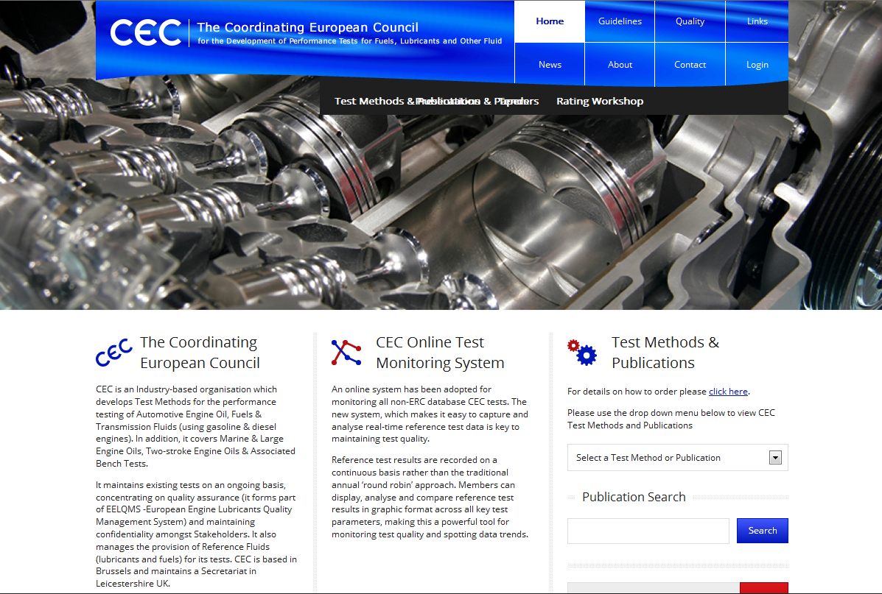
CEC - Website: www.CECtests.org

